Slide 1
Applying Integrated Uncertainty Package to Simple Pipe

Slide 2
Simple pipe problem
25 foot long vertical pipe
1 sq. ft. flow area
Water
Sink pressure - 50. Psia
Source pressure - 150 Psia
Temperature - 120 º F

Slide 3
Simple pipe problem with pipe wall
110
TMDPVOL
120
SNGLJUN
Heat Structure representing
the wall of the pipe
Pipe
125
SNGLJUN
127
TMDPVOL
130
Right Boundary

Slide 4
Uncertainty input models
Base input model
Setup model
  Uncertainty model options
  Source and input parameters
  Parameter uncertainty distributions
Post processing model
  Output parameters with uncertainty limits

Slide 5
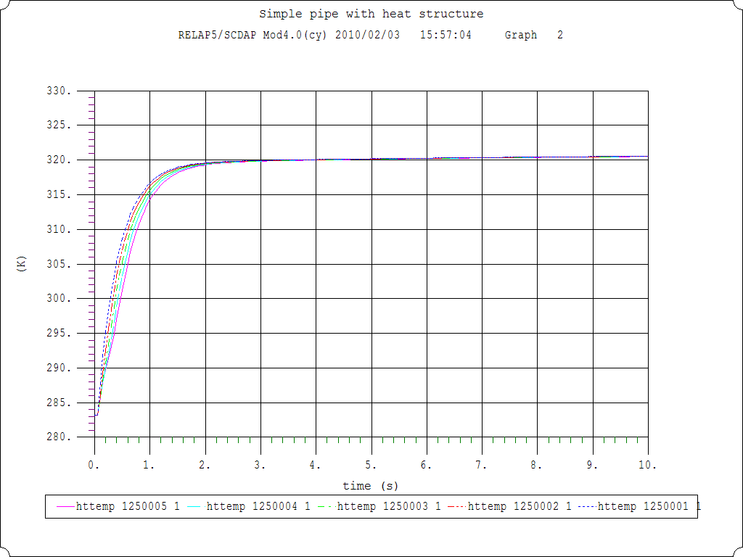
Base case results

Slide 6
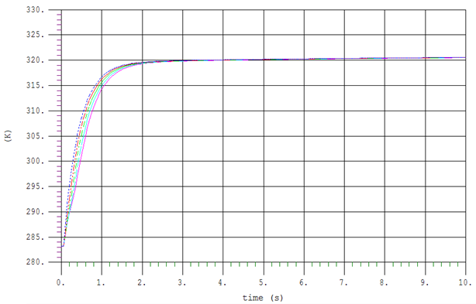
Top of pipe
Inner Surface Temperature (K)
Time (s)

Slide 7
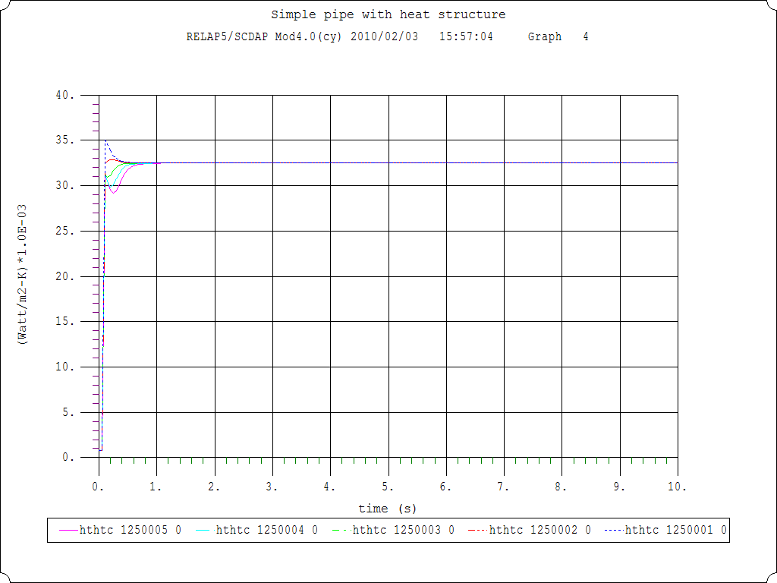
Base case results

Slide 8
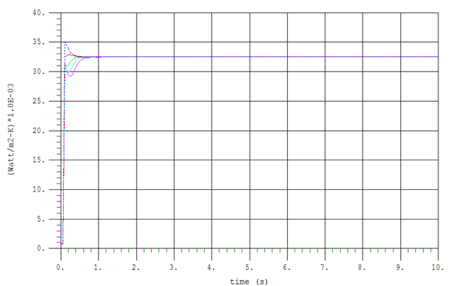
Heat Transfer Coefficient (kW/m² – K)
Time (s)

Slide 9
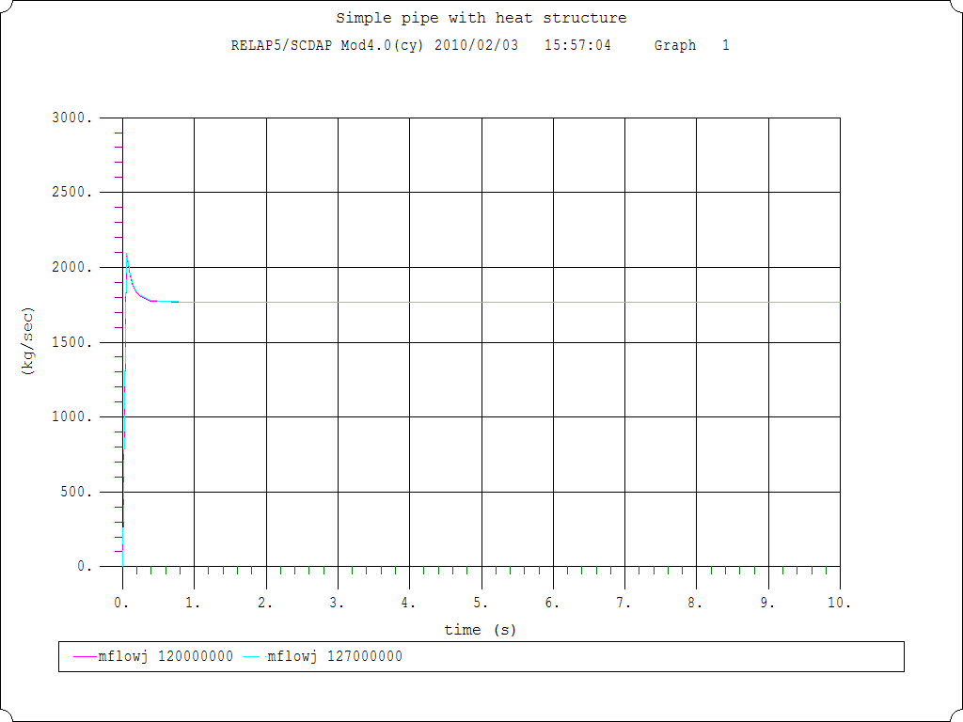
Base case results

Slide 10
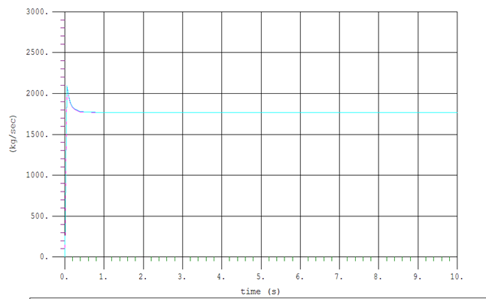
Mass Flow (Kg/s)
Time (s)

Slide 11
Sensitivity studies
Source parameters
  Liquid heat transfer coefficient + 20%
  Liquid heat transfer viscosity + 2%
  Liquid heat transfer thermal conductivity + 2%
Input parameters
  Source pressure + 20%
  Inlet junction area + 20%

Slide 12
Setup input model
= Setup of uncertainty option for simple pipe
100 uncsetup
*Defaults to use Wilk's formula application with 95% confidence with order 1
*Defaults for min/max number of runs and initial seed for random sampling
29000000 0 0 0.95 0.95 1
* Source coef dist. mean std wt no.
29000001 HTC.02.101 ND 1.0 0.10 0.00 0.00 -1.0 0.0 *Heat transfer coef.
29000002 VIS.LW.LIQ ND 1.00 0.02 0.00 0.00 -1.0 0.0 *Liquid viscosity
29000003 CON.LW.LIQ ND 1.00 0.02 0.00 0.00 -1.0 0.0 *Liquid thermal cond.
29101000 ND 1.0 0.2 0.0 0.0
* Source pressure Junction area
29101001 -1.0 20 1100201 2 2 1 -1.0 20 1200101 3 3 1 *Input parameters
*Base input deck
*100 new transnt
.
.

Slide 13
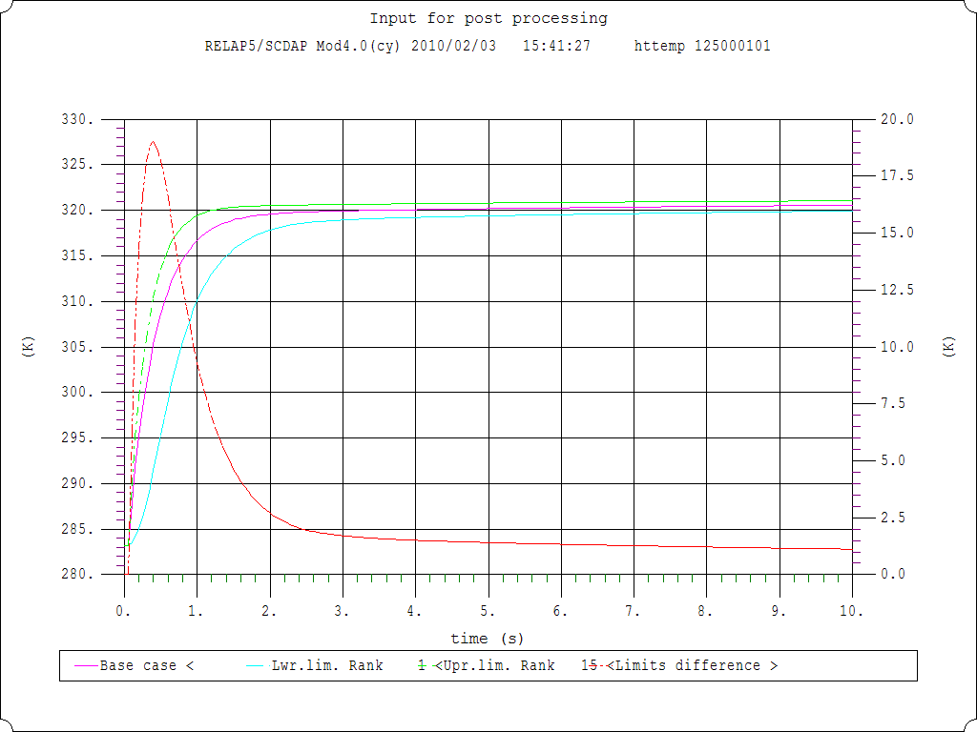
Variation Between Upper and Lower Bound (K)
Inner Surface Temperature and Associated Bounds (K)
Time (s)

Slide 14
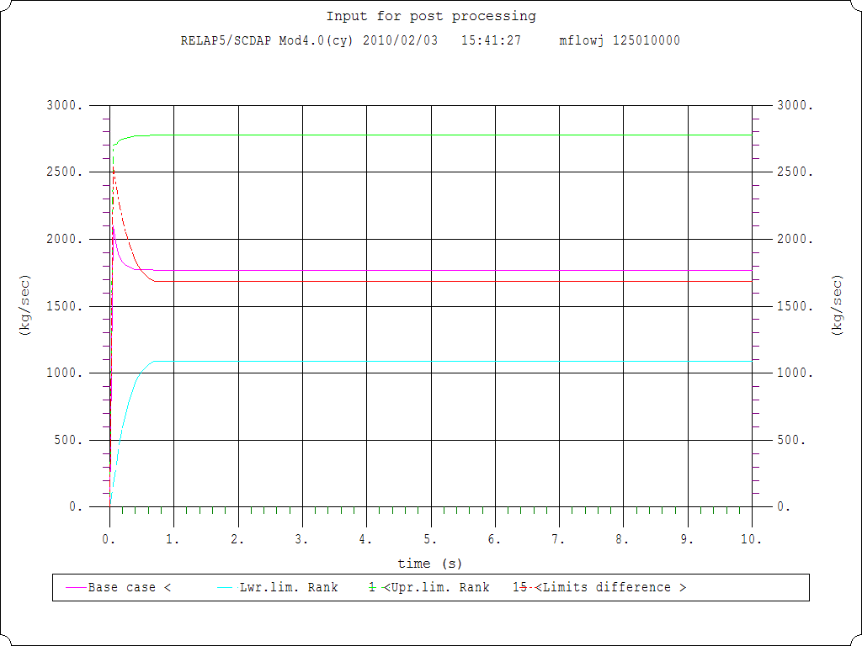
Mass Flow and Associated Bounds (kg/s)
Variation Between Upper and Lower Bound (kg/s)
Time (s)

Slide 15
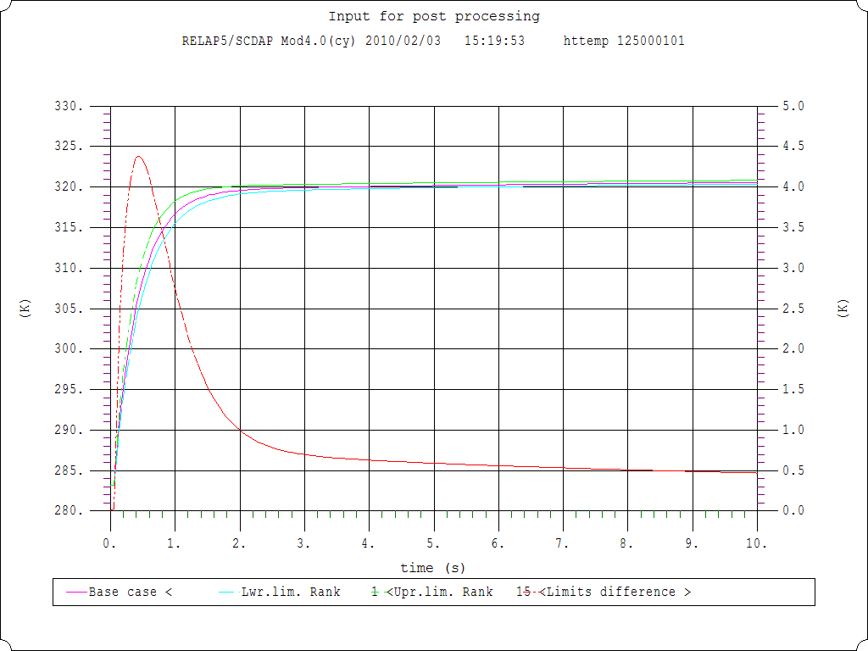
Influence on inner surface temperature
All parameters
HTC only

Slide 16
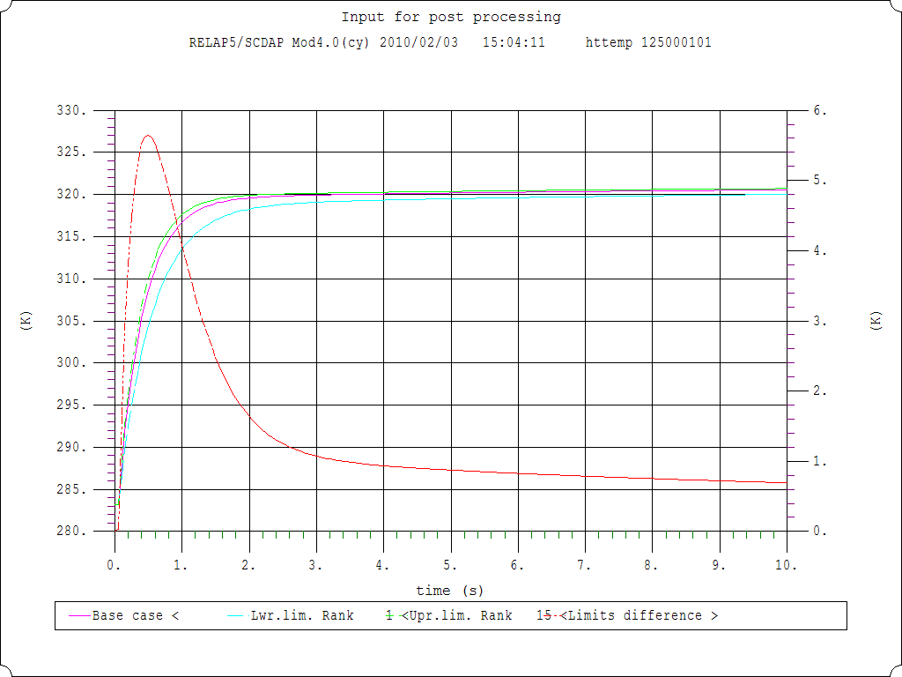
Influence on inner surface temperature
Adding Viscosity
HTC only

Slide 17
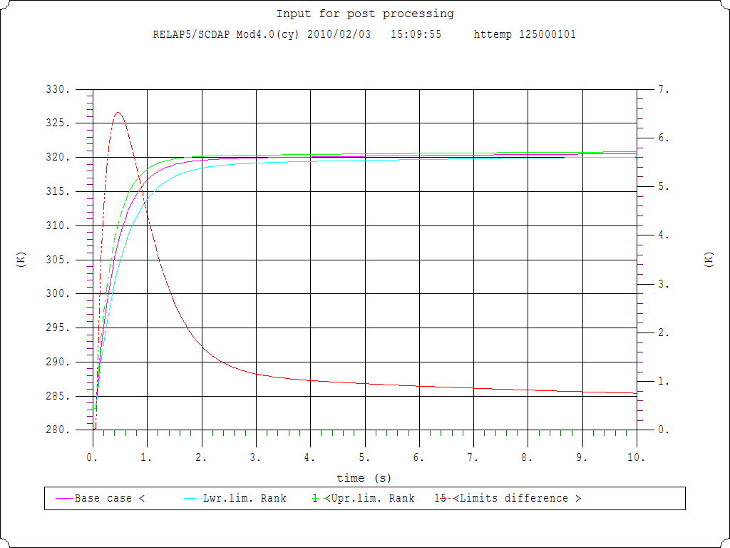
Influence on inner surface temperature
Adding Viscosity
Adding Ther. Cond.

Slide 18
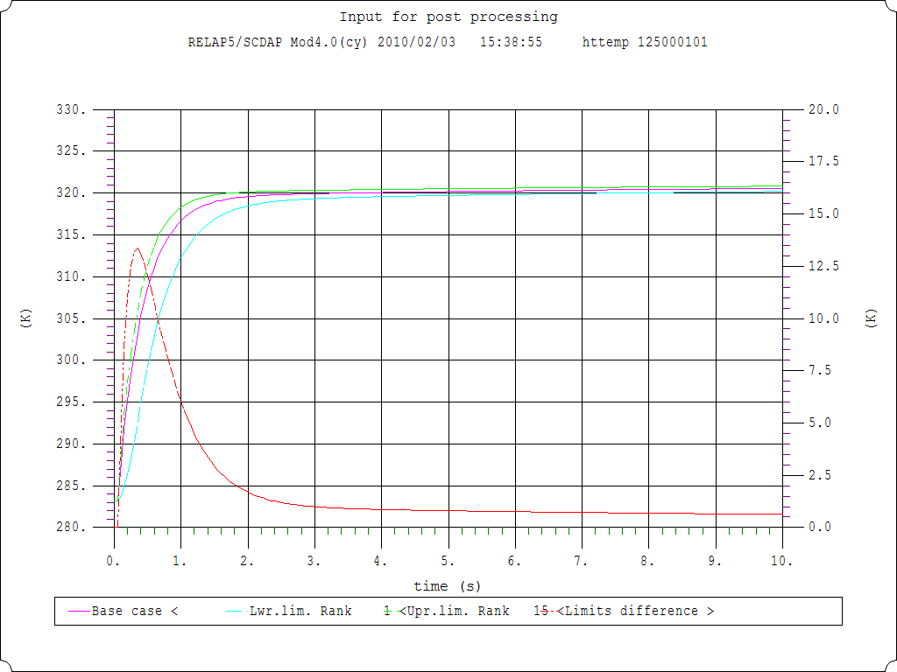
Influence on inner surface temperature
Adding Pressure Change
Adding Ther. Cond.

Slide 19
Influence on mass flow

Slide 20
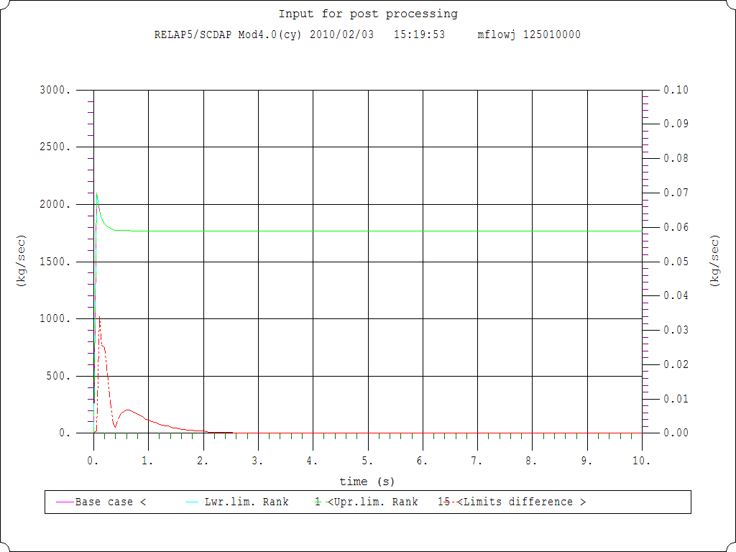
Influence on mass flow
All parameters
HTC only

Slide 21
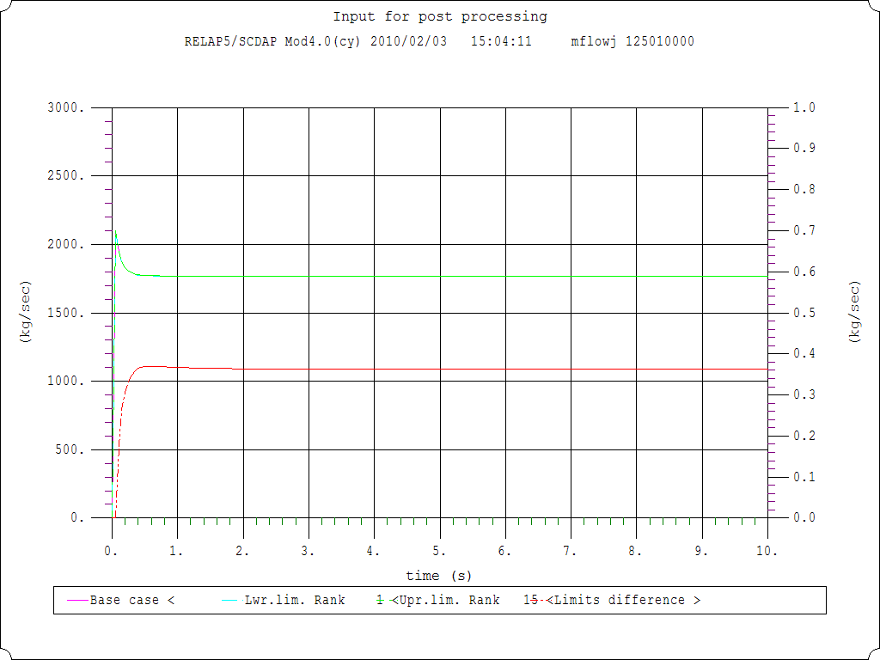
Influence on inner surface temperature
Adding Viscosity
HTC only

Slide 22
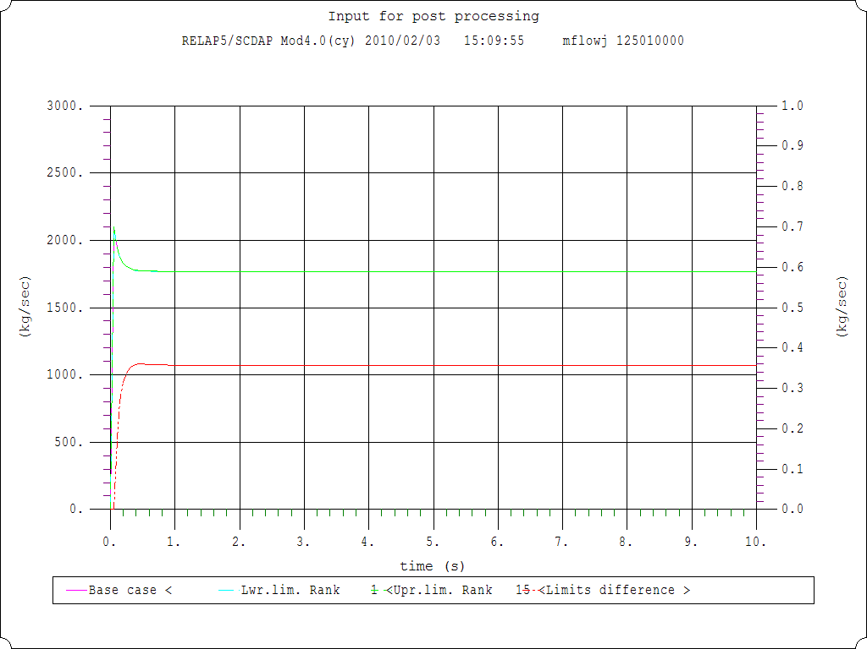
Influence on inner surface temperature
Adding Viscosity
Adding Ther. Cond.

Slide 23
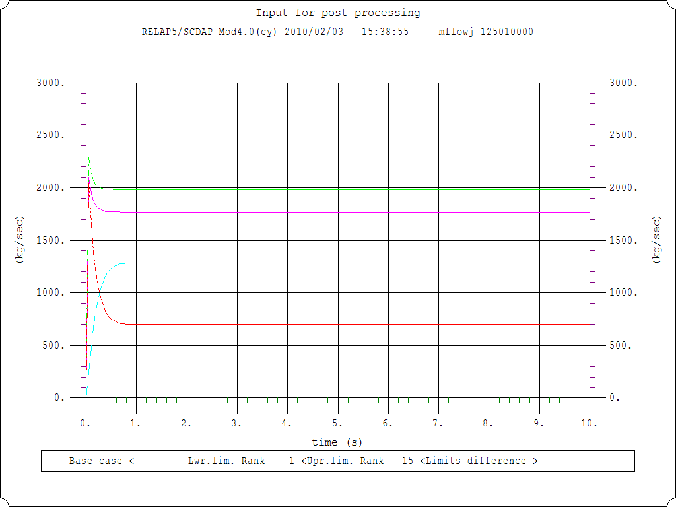
Influence on inner surface temperature
Adding Pressure Change
Adding Ther. Cond.

Slide 24
Influence on inner surface temperature
Adding Pressure Change
All parameters

